Slide 1


Deep Dive on AWS DevOps CI/CD Tooling
Wolfgang Unger
AWS Solutions architect | INSTRUCTOR
DevOps concepts, best practices and how to use AWS CodeCommit, CodeBuild, CodeDeploy and CodePipeline.

Slide 2

Deep Dive on AWS DevOps CI/CD Tooling
Wolfgang Unger
AWS Solutions Architect | instructor

Slide 3


Course overview
Deep Dive on AWS DevOps CI/CD Tooling
Course Overview
CodeCommit
CodeBuild
CodeDeploy & CodePipeline
Summary
Wolfgang Unger
AWS |Solutions Architect | Instructor

Slide 4

Course overview
1
CodeCommit
A version control service hosted by Amazon Web Services that you can use to privately store and manage files, such as documents, source code, and binary files in the cloud
2
CodeBuild
A fully managed continuous integration service that compiles source code, runs tests, and produces software packages that are ready to deploy
3
CodeDeploy
a fully managed deployment service that automates software deployments to a variety of compute services such as Amazon EC2, AWS Fargate, AWS Lambda, and your on-premises servers
4
CodePipeline
a fully managed continuous delivery service that helps you automate your release pipelines for fast and reliable application and infrastructure updates

Slide 5
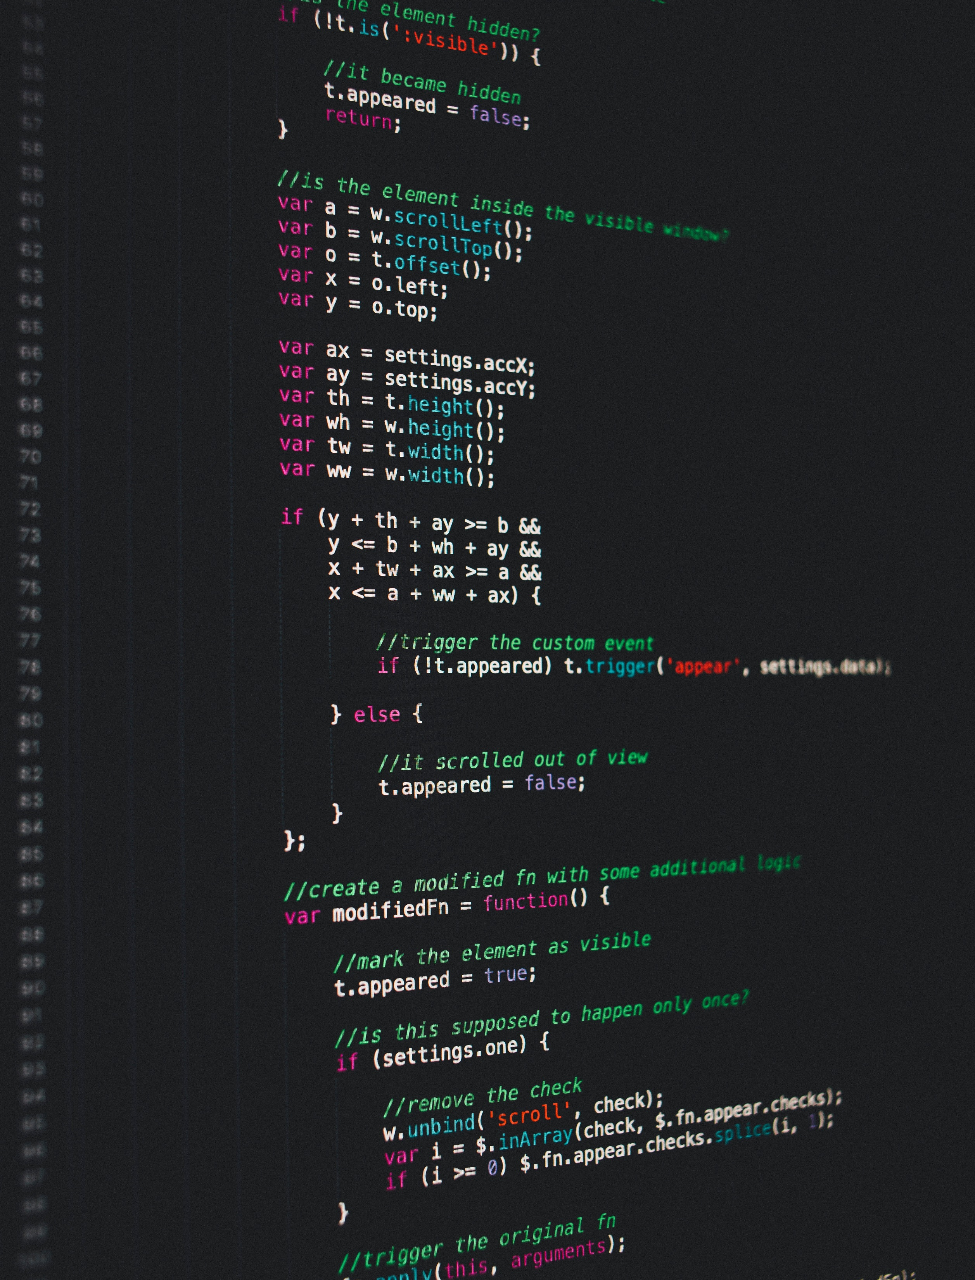
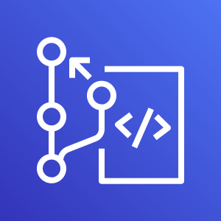
CodeCommit
Feature 1
Master
Feature 2
store and manage assets (such as documents, source code, and binary files) in a private GIT based repository

Slide 6
CodeCommit
Introduction and chapter overview
Create first CodeCommit Repo
Browse files in Repo
Integration with Eclipse and VisualStudio
Triggers and webhooks
Branches
Pull requests
Summary

Slide 7

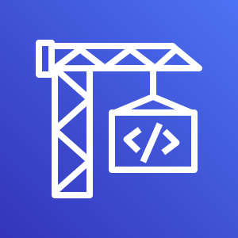
CodeBuild
compile
test
package
compiles your source code, runs unit tests, and produces artifacts that are ready to deploy. The build can be maven, gradle, docker or others

Slide 8
CodeBuild
Introduction and chapter overview
Providers
First CodeBuild project
Docker example project
Input sources and output artifacts
Static website example project
Lambda example project
Monitoring codebuild
Env variables
Summary

Slide 9

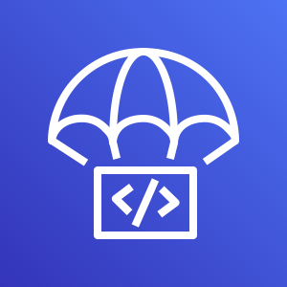
CodeDeploy
01100110
11001101
10000101
11100111
deploys your code to Amazon EC2 instances, on-premises instances, serverless Lambda functions, or Amazon ECS services.

Slide 10

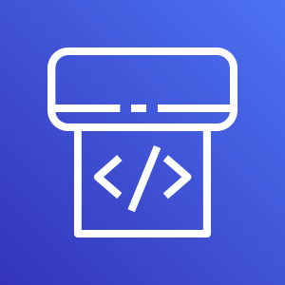
CodePipeline
source
build
deploy
models, visualizes, and automates the steps required to release your software.

Slide 11
CodeDeploy and CodePipeline
Introduction and chapter overview
First pipeline with CodeCommit repo
Create ECS deploy pipeline
Create a pipeline with cloud formation
Create android app pipeline
Stages
Cloudwatch events, webhooks and change triggers
Summary

Slide 12
Title Text
The big picture
CodeCommit
CodeBuild
CodeDeploy
Manages your source code and all resources like properties, XML, JSON files for your project.
Builds your projects and creates one or more output artifacts
Deploys your project to your target environment or AWS service and stage

Slide 13
Title Text
The big picture
CodePipeline
Manages the complete build pipeline from source over build to deployment
CodeCommit
CodeBuild
CodeDeploy
Manages your source code and all resources like properties, XML, JSON files for your project.
Builds your projects and creates one or more output artifacts
Deploys your project to your target environment or AWS servie and stage

Slide 14
Deep Dive on AWS DevOps CI/CD Tooling
Wolfgang Unger
AWS Solutions Architect | instructor

